Slide 1

HCF and LCM

Slide 2
Factors
Number of factors
LCM & HCF
Prime Factorization Method
Sum of factors
Product of factors
Number of odd and even factors
Problems related to same and different remainders
Data Sufficiency on related topic
Relation b/w LCM & HCF

Slide 3
Factors and Multiples : All the numbers that divide a number completely, i.e., without leaving any remainder, are called factors of that number. For example, 24 is completely divisible by 1, 2, 3, 4, 6, 8, 12, 24. Each of these numbers is called a factor of 24 and 24 is called a multiple of each of these numbers.
FACTORS

Slide 4
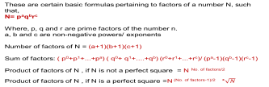
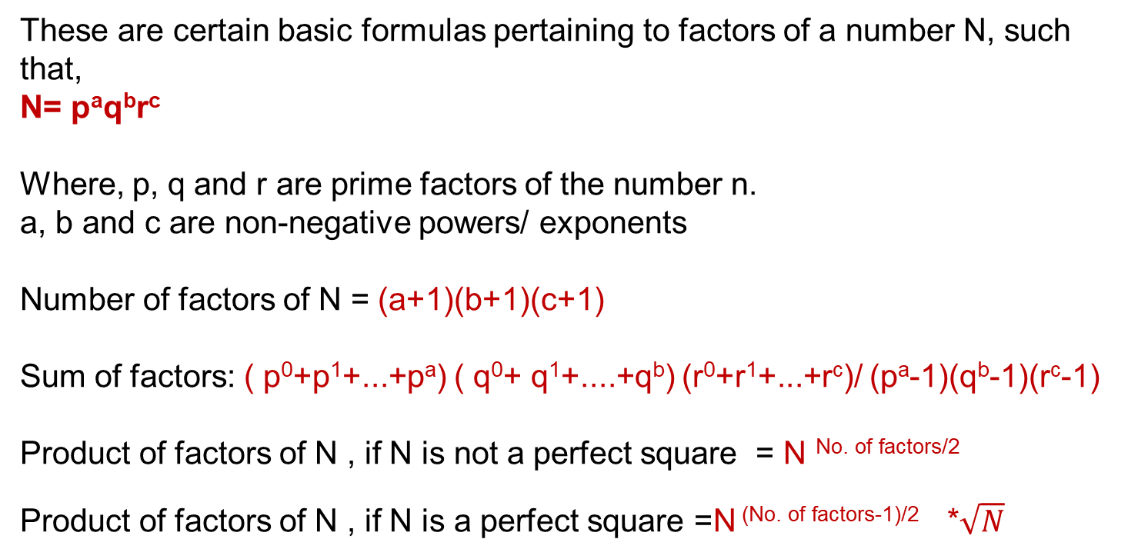
FACTORS
What are Factors of a number?
Factors of a number N refers to all the numbers which divide N completely. These are also called divisors of a number.
These are certain basic formulas pertaining to factors of a number N, such that,
N= pªq^{b}r^{c}
Where, p, q and r are prime factors of the number n.
a, b and c are non-negative powers/ exponents
Number of factors of N = (a+1)(b+1)(c+1)
Sum of factors: ( p⁰+p¹+...+pª) ( q⁰+ q¹+....+q^{b}) (r⁰+r¹+...+r^{c})/ (pª-1)(q^{b}-1)(r^{c}-1)
Product of factors of N , if N is not a perfect square = N ^{No. of factors/2}
Product of factors of N , if N is a perfect square =N ^{(No. of factors-1)/2} *$\sqrt{N}$

Slide 5
FACTORS
Number of even Factors and odd factors:
Let N as a number.
N in prime factorization = a^p × b^q × c^r
No. of factors of N = (p+1)(q+1)(r+1)
Now suppose that b and c are odd prime numbers in prime factorization of N
Now to find even no of factors you have to find odd no of factors first.
Odd no of factors = (q+1)(r+1)
Even no of factors = (total no of factors) - (odd no of factors).

Slide 6
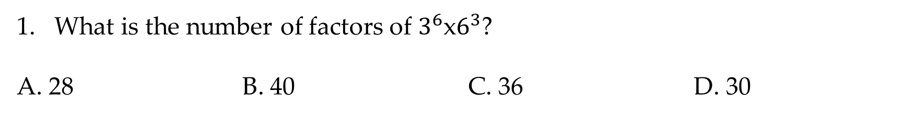
FACTORS
What is the number of factors of $3^{6}$x$6^{3}$?
A. 28 B. 40 C. 36 D. 30
Notes:
Difficulty Level: Easy(compulsory)
Option B

Slide 7
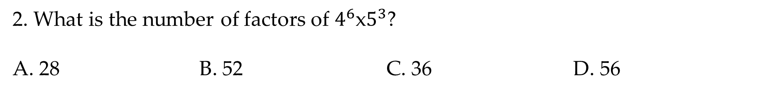
FACTORS
2. What is the number of factors of $4^{6}$x$5^{3}$?
A. 28 B. 52 C. 36 D. 56
Notes:
Difficulty Level: Easy
Option B

Slide 8
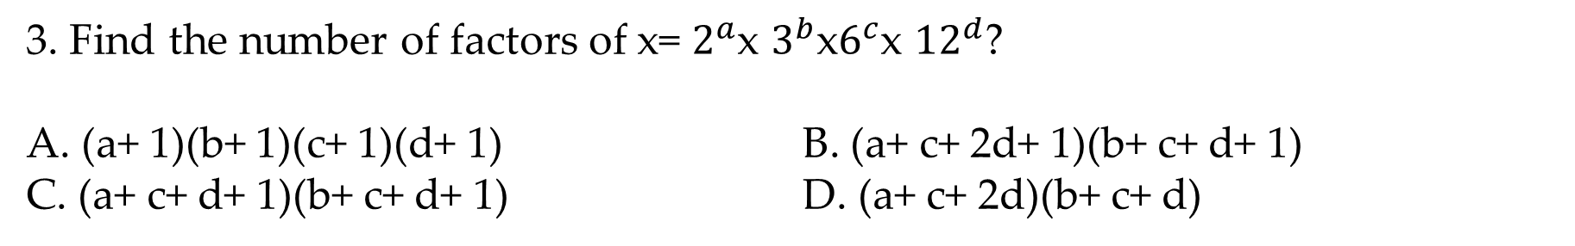
FACTORS
3. Find the number of factors of x= $2^{a}$x $3^{b}$x$6^{c}$x ${12}^{d}$?
A. (a+ 1)(b+ 1)(c+ 1)(d+ 1) B. (a+ c+ 2d+ 1)(b+ c+ d+ 1)
C. (a+ c+ d+ 1)(b+ c+ d+ 1) D. (a+ c+ 2d)(b+ c+ d)
Notes:
Difficulty Level: Moderate (compulsory)
Option B

Slide 9
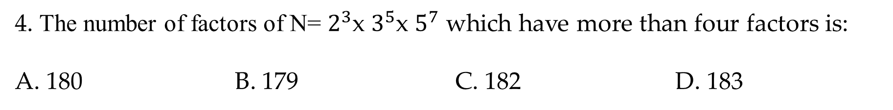
FACTORS
4. The number of factors of N= $2^{3}$x $3^{5}$x $5^{7}$ which have more than four factors is:
A. 180 B. 179 C. 182 D. 183
Notes:
Difficulty Level: Moderate (compulsory)
Option B

Slide 10
FACTORS
5. What is the sum of the factors of 221?
A. 222 B. 251 C. 252 D. 262
Notes:
Difficulty Level: Moderate (compulsory)
Option C

Slide 11
FACTORS
6. What is the sum of the factors of 120?
A. 22 B. 51 C. 45 D. 62
Notes:
Difficulty Level: Moderate (compulsory)
Option C

Slide 12
FACTORS
7. What is the Product of the factors of 120?
A. 120⁶ B. 120⁷ C. 120⁸ D. 121⁸
Notes:
Difficulty Level: Moderate (compulsory)
Option C

Slide 13
FACTORS
8. What is the Product of the factors of 300?
A. 300⁶ B. 300⁸ C. 300⁹ D. 300⁷
Notes:
Difficulty Level: Moderate (compulsory)
Option C

Slide 14
FACTORS
9. Find the number of even factors of 84?
A. 8 B. 7 C. 6 D. 9
Notes:
Difficulty Level: Moderate (compulsory)
Option A

Slide 15
FACTORS
10. Find the number of odd factors of 2² * 3¹ * 5²?
A. 4 B. 5 C. 3 D. 6
Notes:
Difficulty Level: Moderate (compulsory)
Option D

Slide 16
LCM : The least number which is exactly divisible by each of the given numbers is called the least common multiple of those numbers. For example, consider the numbers 3, 31 and 62 (2 x 31). The LCM of these numbers would be 2 x 3 x 31 = 186.
HCF and LCM

Slide 17
HCF : The largest number that divides two or more numbers is the highest common factor (HCF) for those numbers. For example, consider the numbers 30 (2 x 3 x 5), 36 (2 x 2 x 3 x 3), 42 (2 x 3 x 7), 45 (3 x 3 x 5). 3 is the largest number that divides each of these numbers, and hence, is the HCF for these numbers. HCF is also known as Greatest Common Divisor (GCD).
HCF and LCM

Slide 18
Find HCF and LCM: By Using Prime factorization method
HCF and LCM
Prime Factorization for HCF:
Take an example of finding the highest common factor of 144, 104 and 160. Now let us write the prime factors of 144, 104 and 160. 144 = 2 × 2 × 2 × 2 × 3 × 3 104 = 2 × 2 × 2 × 13 160 = 2 × 2 × 2 × 2 × 2 × 5 The common factors of 144, 104 and 160 are 2 × 2 × 2 = 8 Therefore, HCF (144, 104, 160) = 8

Slide 19
HCF and LCM
LCM By Prime Factorisation:
To calculate the LCM of two numbers 60 and 45. Out of other ways, one way to find the LCM of given numbers is as below:
List the prime factors of each number first. 60 = 2 × 2 x 3 × 5 45 = 3 × 3 × 5
Then multiply each factor the most number of times it occurs in any number.
If the same multiple occurs more than once in both the given numbers, then multiply the factor the most number of times it occurs. The occurrence of Numbers in the above example: 2: two times 3: two times 5: one time LCM = 2 × 2 x 3 × 3 × 5 = 180

Slide 20
HCF and LCM
Relationship between HCF & LCM
The product of HCF (Highest common factor) and LCM(lowest common multiple) of two numbers is equal to the product of two numbers.
HCF X LCM = Product of two given numbers

Slide 21
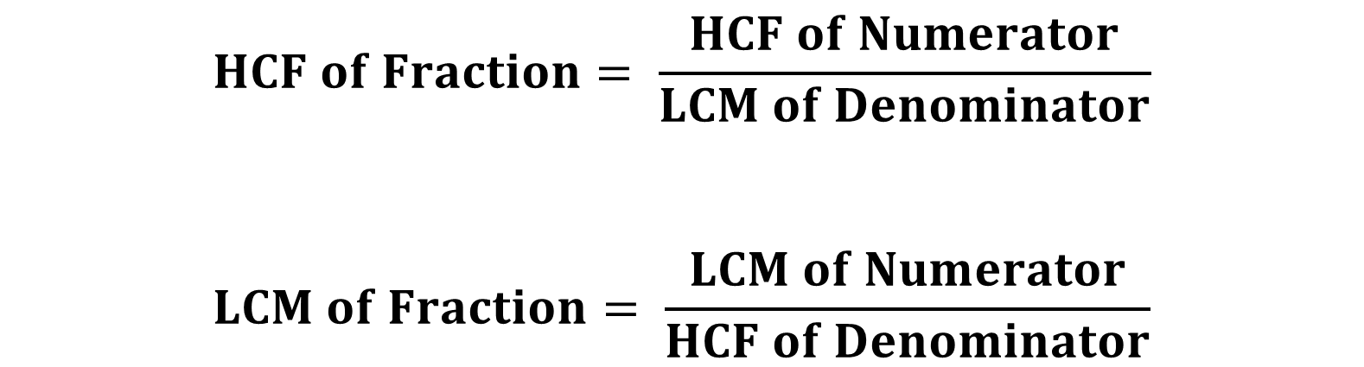
HCF & LCM OF A FRACTION
HCF and LCM
$$HCF of Fraction= \frac{HCF of Numerator}{LCM of Denominator}$$
$$LCM of Fraction= \frac{LCM of Numerator}{HCF of Denominator}$$

Slide 22
HCF and LCM
11. Find the L.C.M. of 2⁴ x 3 x 11, 2⁵ x 3 and 2³ x 11?
A. 96 B. 88 C. 132 D. 1056
12. Find the H.C.F. of 2⁴ x 3 x 11, 2⁵ x 3 and 2³ x 11?
A. 96 B. 8 C. 132 D. 1056
Notes:
Difficulty Level: Moderate
Option D (Compulsory)
Option B

Slide 23
HCF and LCM
13.The HCF and LCM of two numbers is 78 and 2340 respectively. If the first number is 390, find the second one?
A. 420 B. 362 C. 312 D. 468
Notes:
Difficulty Level : Easy(Compulsory)
Option D

Slide 24
HCF and LCM
14. The sum of two numbers is 231 and their H.C.F is 33. The number of pairs of numbers satisfying the above conditions is?
A. 3 B. 6 C. 8 D. 12
Notes:
Option A

Slide 25
HCF and LCM
15. Find the HCF of 5/12, 7/18 and 19/24?
A. 1/72 B. 1/36 C. 25/57 D. 5/48
Notes:
Difficulty Level: Easy(compulsory)
Option A

Slide 26
HCF and LCM
16. Find the least number exactly divisible by 9, 10, 15, 18 and 30?
A. 85 B. 90 C. 88 D. 93
Notes:
Difficulty level; Easy
Option B

Slide 27
HCF and LCM
17. Find the smallest number of 4 digits which is exactly divisible by 12, 30, 42 and 60?
A. 1580 B. 1420 C. 1260 D. 1056
Notes:
Difficulty Level : Hard (Compulsory)
Option C

Slide 28
HCF and LCM
18. Find the least number which when divided by 30, 42, 48 and 32 leaves the same remainder 2 in each case?
A. 3362 B. 3360 C. 3456 D. 3262
Notes:
Difficulty Level : Moderate(Compulsory)
Option A

Slide 29
HCF and LCM
19. Find the least number which when divided by 4, 10, 12 and 18 leaves a remainder 3 but leaves no remainder when same number is divided by 11?
A. 281 B. 357 C. 360 D. 363
Notes:
Option D

Slide 30
HCF and LCM
20. Find the least number which when divided by 9, 15, 30 and 45 leaves remainders 5, 11, 26 and 41 respectively?
A. 72 B. 80 C. 85 D. 86
Notes:
Difficulty Level : Hard (Compulsory)
Option D

Slide 31
HCF and LCM
21. Find the least number which when divided by 12, 15, 30 and 40 leaves remainder 10, 13, 28 and 38 respectively?
A. 124 B. 116 C. 120 D. 118
Notes:
Option D

Slide 32
HCF and LCM
22. Find the greatest number that will divide 44, 92, and 184 so as to leave the same remainder in each case?
A. 5 B. 7 C. 4 D. 9
Notes:
Difficulty Level : Hard (Compulsory)
Option C

Slide 33
HCF and LCM
23. A milk vendor has three kinds of milk: 85 litres, 136 litres and 51 litres. Find the least number of casks of equal size required to store all the milk without mixing?
A. 15 B. 16 C. 25 D. 30
Notes:
Difficulty Level : Easy (Compulsory)
Option B

Slide 34
HCF and LCM
Directions (24-25) In each of the questions below consists of a question and two statements numbered I and II given below it. You have to decide whether the data provided in the statements are sufficient to answer the question. Read both the statements and;
Give answer:
A. If the data in statement I alone are sufficient to answer the question, while the data in statement II alone are not sufficient to answer the question.
B. If the data in statement II alone are sufficient to answer the question, while the data in statement I alone are not sufficient to answer the question.
C. If the data either in statement I alone or in statement II alone are sufficient to answer the question.
D. If the data given in both statements I and II together are not sufficient to answer the question and;
E. If the data in both statements I and II together are necessary to answer the question.

Slide 35
HCF and LCM
24. Find the Ratio of two numbers?
Statement I: LCM of two numbers is 210.
Statement II: HCF of two numbers is 5.
Notes:
Difficulty Level : Moderate (Compulsory)
Option D

Slide 36
HCF and LCM
25. Find the largest of the two numbers?
Statement I: The HCF of two numbers is 10 and their product is 600.
Statement II: The sum of the two numbers is 50.
Notes:
Option E

Slide 37
Any Doubts???

